Slide 1
SOF 103
C and C++ Programming
Chapter 6
Pointers

Slide 2
Pointers
A pointer is the memory address of the variable.
It gives you more control of the computer’s memory.
Pointers can be used to implement dynamic arrays and other data structures such as linked list, stack and queues.

Slide 3
Pointer Variables
A pointer can be stored in a variable.
Though pointer is a memory address and a memory address is an integer, you can’t store a pointer in a variable of type int or double without typecasting.
A variable to hold a pointer must be declared to have a pointer type, e.g.,
double *p
The variable p can hold pointers to variables of type double only.

Slide 4
Cont…
Declaration of pointer variables of type int along with two ordinary variables of type int:
int *p1, *p2, v1, v2;
There must be an asterisk before each of the pointer variables.
Setting the variable p1 equal to a pointer that points to the variable v1:
p1 = &v1;
Here, the pointer variable is said to point to the variable v1 or to be a pointer to the variable v1

Slide 5
Cont…
Some pointer declarations:
  char *cptr; // pointer to char
  int *iptr; // pointer to int
  float *fptr; // pointer to float
  Distance *distptr; // pointer to user-defined Distance class
int* iptr; or int *iptr;
int *iput, v1;
  iput=&v1;
  *iput=10; //Here ‘*’ is used as a dereference operator

Slide 6
A code snippet
int *p1, v1;
v1 = 0;
p1 = &v1;
*p1 = 42;
cout << v1 << endl;
cout << *p1 << endl;
This code outputs the following to the screen:
42
42

Slide 7
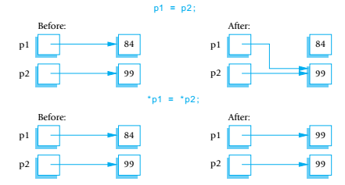
Uses of Assignment Operator

Slide 8
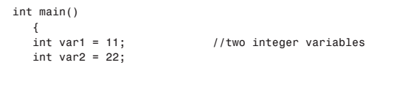
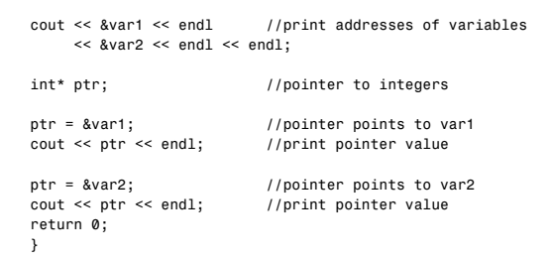
Pointer Variables - Program

Slide 9
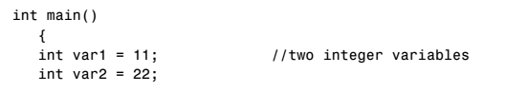
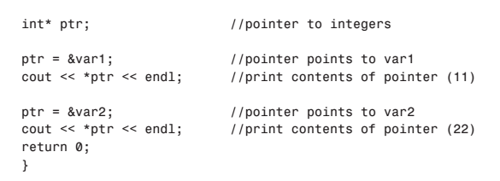
Accessing the Variable Pointed to

Slide 10
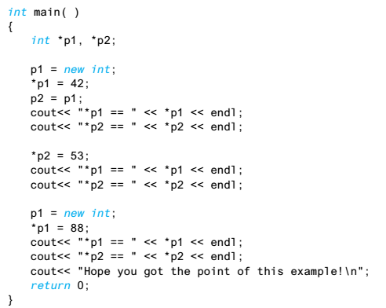
Pointers and Dynamic Variables

Slide 11
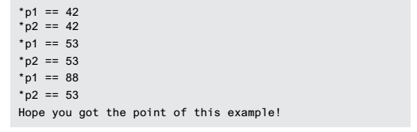
Cont…
Program Output

Slide 12
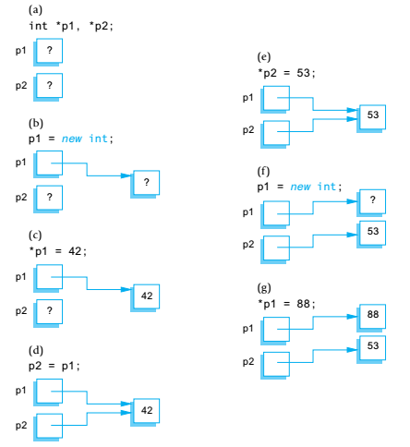
Cont…
Explanation

Slide 13
Basic Memory Management
freestore – A special area of memory reserved for dynamic variables.
The size of freestore depends on the system and the compiler.
If a program creates too many dynamic variables, it may consume whole freestore area.
Additional calls to new may fail.
It is a good practice to recycle any freestore memory that is no longer needed.
This can be accomplished by using delete operator:
  delete p;

Slide 14
Defining Pointer Types
You can simplify the task of defining pointer types.
Following defines a type called IntPtr, for pointer to int variables:
  typedef int* IntPtr;
Thus, the following statements are equivalent:
  IntPtr p;
  int *p;

Slide 15
Dynamic Arrays
Array variables are actually pointer variables.
Unlike static array, the size of dynamic array is specified at run-time.
Given the following two variable declarations, p and a are the same kind of variable:
int a[10];
typedef int *IntPtr;
IntPtr p;
The value of a can be assigned to the pointer variable ‘p’ as follows:
  p=a;

Slide 16

Array variable is a kind of pointer variable
#include<iostream>
using namespace std;
int main()
{
typedef int *IntPtr;
IntPtr p;
int a[10];
int i;
for(i=0;i<10;i++)
a[i]=i;
p=a;
for(i=0;i<10;i++)
cout<<p[i]<<" ";
cout<<endl;
for(i=0;i<10;i++)
p[i]=p[i]+1;
for(i=0;i<10;i++)
cout<<a[i]<<" ";
cout<<endl;
return 0;
}

Slide 17
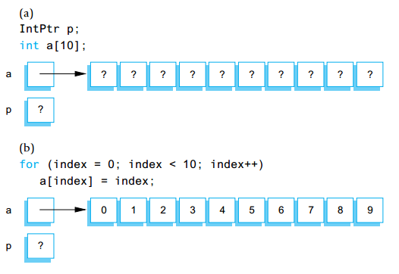
Explanation

Slide 18
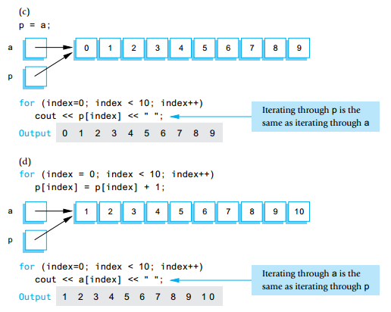
Explanation

Slide 19
How to Use a Dynamic Array?
Define a pointer type:
  typedef double* DoubleArrayPtr;
Declare a pointer variable:
  DoubleArrayPtr a;
Call new:
  a = new double[array_size];
Use like an ordinary array:
  a[0], a[1] and so on…
Call delete[]:
  delete [] a;
Size can be an int variable or an expression, and is determined at run-time

Slide 20
The Relationship between Pointers and Arrays
Consider the following declarations:
  int b[5];
  int *bptr;
  bptr = b;
  bptr = &b[0];
Equivalent

Slide 21
Cont…
Array element b[3] can alternatively be referenced with the pointer expression,
*(bPtr + 3)
The 3 in the above expression is the offset to the pointer. The parentheses () are necessary because the precedence of * is higher than the precedence of +. Without the parentheses (), the above expression would add 3 to the expression *bPtr (i.e. 3 would be added to the b[0] assuming bPtr points to the beginning of the array).
The address &b[3] can be written with the pointer expression
bPtr + 3

Slide 22
Cont…
The array itself can be treated as a pointer and used in pointer arithmetic. For example, the expression
*(b + 3)
also refers to the array element b[3].
Pointers can be subscripted exactly as arrays can. For example, the expression,
bPtr[1]
refers to the array element b[1]. This expression is referred to as pointer/subscript notation.

Slide 23
Cont…
The array name is a constant pointer. It always points to the beginning of the array. Therefore, the expression
b += 3
is invalid because it attempts to modify the value of the array name with pointer arithmetic.

Slide 24
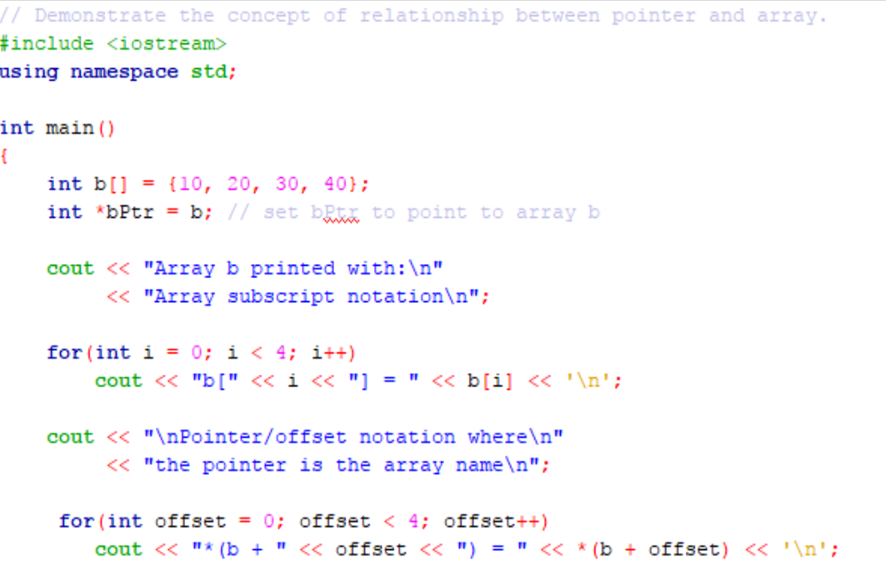
Program to demonstrate the relationship between array and pointer

Slide 25
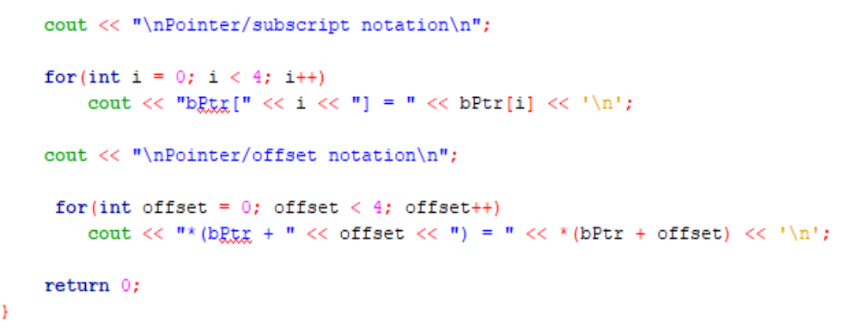
Cont…

Slide 26
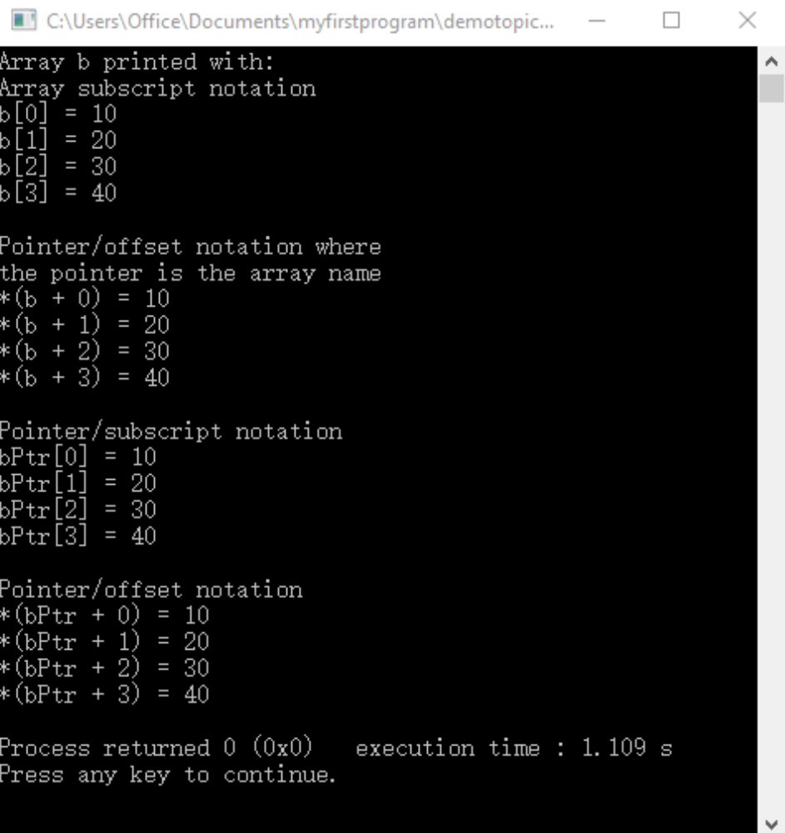
Output

Slide 27
Pointer to a string and character array
A string may be assigned in a declaration to either a character array or a variable of type char *.
Consider the declarations:
char colour[] = “blue”;
char *colourPtr = “blue”;
Each initialize a variable to the string “blue”.
The first declaration creates a 5-element array colour containing characters ‘b’, ‘l’, ‘u’, ‘e’ and ‘\0’.
The second declaration creates a pointer variable colourPtr that points to the string “blue” somewhere in memory.

Slide 28
Array of Pointers
Array may contain pointers. A common use of this data structure is to form an array of strings, referred to as string array.
Each entry in the array is a string, but in C++ a string is essentially a pointer to its first character.
So each entry in an array of strings is actually a pointer to the first character of a string.
An example is
char *colour[3] = {“red”, “green”, “blue”};
The colour[3] indicates an array of 3 elements. The char * indicates that each element of array colour is of type “pointer to char”.

Slide 29
Cont…
Each of these is stored in memory as a null-terminated character string that is one character longer than the number of characters between quotes.
The three strings are 4, 6 and 5 characters long, respectively.
A graphical representation of an array of pointer is shown in example below.
colour[0]
•
‘r’
‘e’
‘d’
‘\0’
colour[1]
•
‘g’
‘r’
‘e’
‘e’
‘n’
‘\0’
colour[2]
•
‘b’
‘l’
‘u’
‘e’
‘\0’

Slide 30
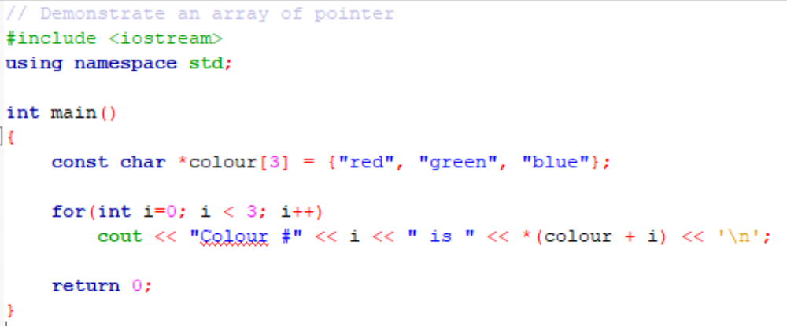
Program to Demonstrate Array of Pointers

Slide 31
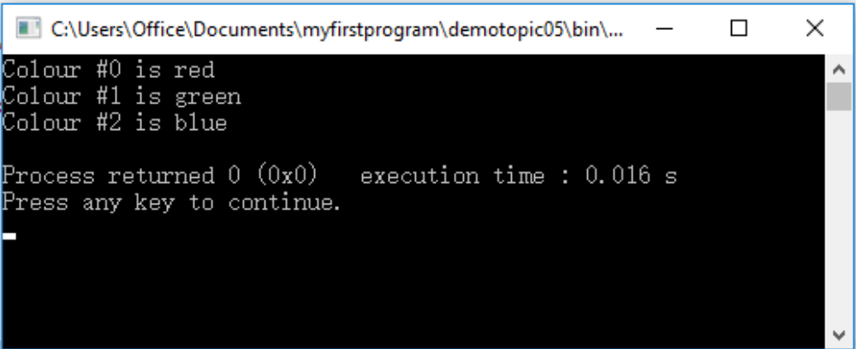
Output

Slide 32
References
  Problem Solving with C++ (10th Edition), Walter Savitch, Addison Wesley, 2018
  Paul J. Dietel, C++ How to Program (10th Edition), Pearson, 2017.
  Turbo C programming for the PC, Robert Lafore
  Dr. Kamran’s notes.

Slide 33
Notes
  When should we use pointers?
  Call by reference / pointer.
  Dynamic memory allocation and dynamic arrays.
  C strings.
  Dynamic data structures.
  2. If not needed, avoid using pointers.
  In the past, using pointers may enhance the run-time efficiency at the implementation level.
  Nowadays, compilers are good at implementation level efficiency optimization.
  Readability is more important.

